Slide 1

Ethical Position Presentation
Gender Selection Through IVF

Slide 2
Introduction
Various ethical provisions guide nursing practice.
Primarily, the American Nurses Association (ANA) avails various ethical provisions to guide the practice.
Although nurses are still faced with ethical dilemmas, even with the adoption of these provisions
An example of these ethical dilemmas is associated with gender selection through in vitro fertilization (IVF) (Asplund, 2020).
Notes:
The nursing profession is often governed by various ethical provisions that ensure the implementation of ethical practices facilitating the safety of the patient and the healthcare professionals in charge. In nursing, the body in charge of this process is the American Nurses Association (ANA), which provides the code of ethics with various provisions (Geiger, 2020). Although there is the existence of ethical requirements, nurses still find themselves in ethical dilemmas that require solutions following the ethical clauses. An excellent example of these ethical dilemmas is associated with gender selection through in vitro fertilization (IVF) (Asplund, 2020). Gender selection in society is often associated with various conflicts, especially among medical approaches, societal beliefs, and religious beliefs.

Slide 3

Ethical Considerations in Nursing
Similar to other professionals, nurses should be conversant with the ethical provisions of the nursing profession.
This knowledge facilitates the effective delivery of the nurses' roles (Geiger, 2020).
The knowledge on ethical considerations also ensures that nurses and patients remain safe.
Notes:
As a nurse, it is often vital to understand the ethical requirements of the profession in detail to implement the required actions when making decisions about the patient's wellbeing. In this case, various ethical considerations are adopted to ensure that the ethical conflict is effectively addressed, and to some extent, similar ethical situations are reduced (Geiger, 2020). In addition, similar to other ethical dilemmas a nurse is bound to experience in the nursing profession, adequate knowledge in the ethical provisions also ensures the safety of the patient and the nurse.

Slide 4
About In Vitro Fertilization (IVF)
In vitro fertilization (IVF) involves the conduction of fertilization outside the female body by professionals (Asplund, 2020).
This process has had a variety of benefits in society, especially to couples in need of help conceiving and in eradicating diseases passed on through genetic properties
The IVF process is also associated with various controversies, especially those advocating for its rejection (Asplund, 2020).
Notes:
According to Asplund (2020), in vitro fertilization refers to a process whereby fertilization is done outside a woman's body and in a laboratory. Precisely, scientists acquire an ovum and a sperm and facilitate fertilization outside the female body. The conduction of this process is often associated with a variety of controversies as organizations, such as some religious organizations, are usually against it (Asplund, 2020). However, this process has had a significant impact on human couples not being able to conceive naturally and identifying embryos with genetic diseases. In addition, although the IVF procedure has facilitated the birth of healthy babies, it has often been used by different couples to facilitate gender selection.

Slide 5
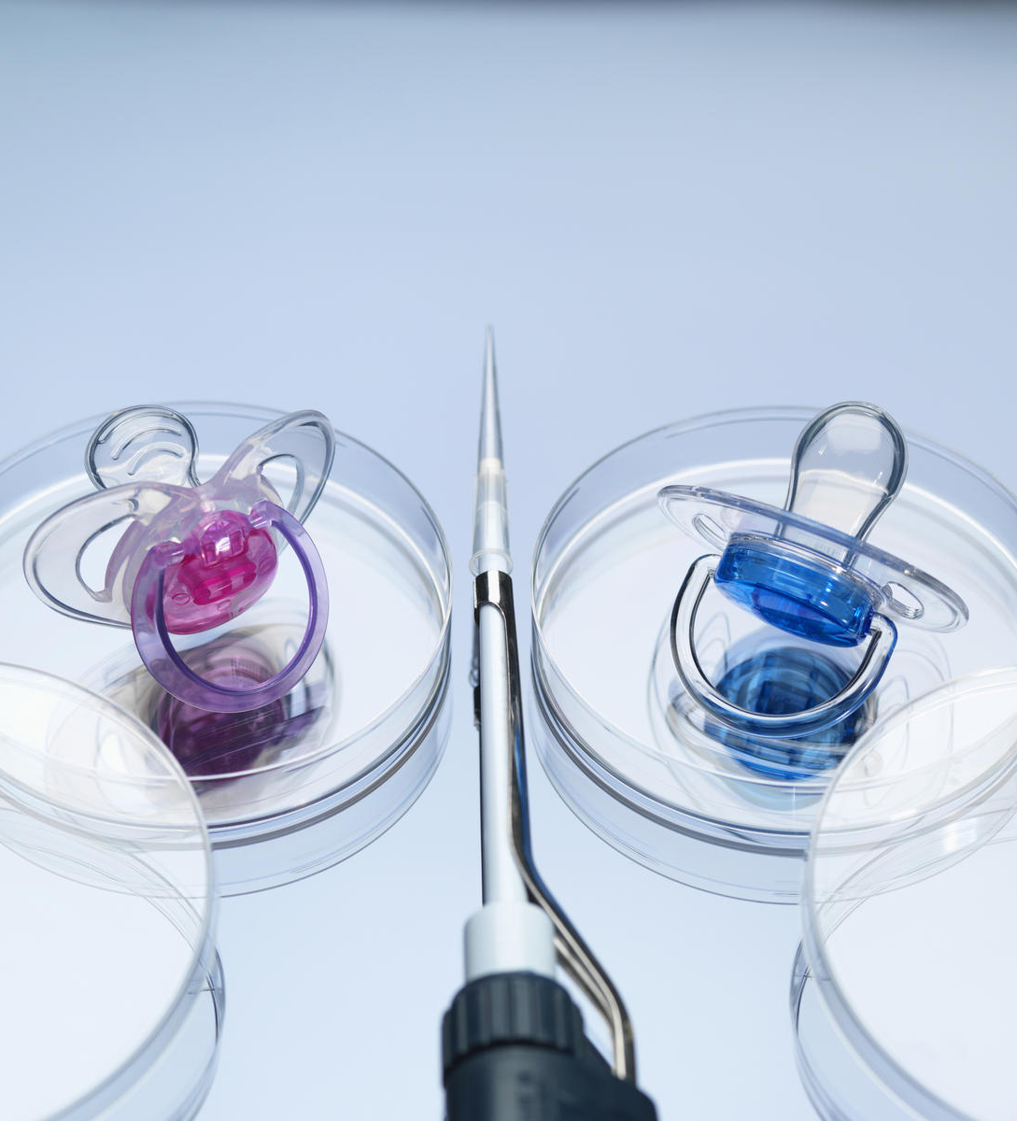
Gender Selection through IVF
With technology advancements, couples have settled on using procedures such as IVF for gender selection in unborn babies.
IVF was primarily developed to detect embryos with genetic diseases and addressing the issue (Capelouto et al., 2018).
The use of IVF for purposes other than the main issue brings about ethical dilemmas in nursing.
Notes:
In some cases, couples seeking to conceive often anticipate a specific gender, which facilitates the implementation of gender selection (Kudina, 2019). Therefore, due to the technological advancements in the medical field, most couples have resulted in IVF. Although the IVF procedure was primarily developed to detect embryos carrying genetic diseases through genetic analysis and embryo biopsy, the technology has also been used in sex selection (Capelouto et al., 2018). Consequently, couples without any medical problems or genetic disease risks are currently visiting IVF clinics for personal reasons such as sex selection, and this has brought about various ethical dilemmas. This is because the IVF process is often associated with multiple medical risks that affect the nursing practice's various ethical provisions.

Slide 6
Application of the Deontological Approach
The deontological approach is a framework often adopted in the ethical analysis of situations (Donaldson, 2017).
In this ethical analysis approach, ethical actions are perceived to facilitate the performance of one's roles.
The ethical dilemma associated with IVF for sex selection should be ethically addressed by implementing ethical interventions that facilitate nurses' ability to perform their role.
Notes:
The ethical issue addressed in this is the case is based on the deontological approach of ethical analysis. According to Donaldson (2017), this approach involves the perception of the correctness of one's actions based on the fulfillment of the actor's duties. In this case, all the concepts used to approach the ethical dilemma strive to present solutions that ensure a nurse faces similar challenges, addresses them ethically, and performs their duties as required. Based on the approach, a nurse is obligated to provide optimal care to a patient concerning various ethical considerations such as their self-determination. Therefore, to ethically address the issue, the outcome of the interventions should ensure that a nurse is able to perform their duties as required.

Slide 7
Ethical Position on Gender Selection through IVF
Based on research, IVF is often associated with various health risks, especially for the baby and the mother.
IVF involves various medical procedures that interfere with the woman's normal functioning of the reproductive system (Asplund, 2020).
If it is not necessary, healthy women should avoid undergoing the procedure, and this can be achieved through nursing professionals employing principles of ethics such as nonmaleficence, beneficence, and autonomy.
Notes:
The conduction of the IVF procedure is often associated with various medical and health risks to the people that undergo the procedure. Moreover, IVF is an example of assisted reproductive technology that is often adopted when other fertility techniques have failed (Asplund, 2020). Precisely, IVF involves various medical procedures that help a woman get pregnant, including superovulation, egg retrieval, which includes minor surgery, insemination and fertilization, embryo culture, and lastly, embryo transfer to the womb. These procedures put the female body at various health risks because the body undergoes stress due to the ovulation medications and the minor surgeries involved (Asplund, 2020). Therefore, for couples without any health issue requiring to undergo the procedure should avoid it, and nurses should apply principles of ethics such as nonmaleficence, beneficence, and autonomy.

Slide 8
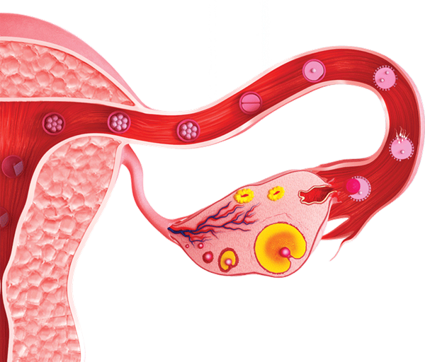
Health Risks Associated with IVF Procedures
Various health risks result from undergoing the IVF procedure.
The risk of ectopic pregnancy in the patient is one of the health risks.
Ovarian hyperstimulation syndrome can also develop due to the medications administered to prepare the body for implantation (Sun et al., 2020).
Notes:
Various health risks are often associated with the IVF affecting both the woman undergoing the procedure and the unborn baby. For instance, undergoing the procedure creates the risk of ectopic pregnancy. This is whereby a fertilized egg attaches itself to other parts other than the uterus. According to Abdulkareem and Eidan (2017), since professionals in the field do the embryo transfer process, it creates the possibility of the embryo attaching itself to other parts. Another significant risk presented by IVF is ovarian hyperstimulation, which is one of the side effects caused by the medication administered to facilitate superovulation. Due to these medications, the ovaries may develop too many follicles resulting in ovarian hyperstimulation syndrome (OHSS) (Sun et al., 2020).

Slide 9
Perceived Pros of Gender Selection through IVF
Various pros are often associated with the use of IVF for gender selection.
For instance, most perceive the procedure as an opportunity to utilize current and updated technology (Capelouto et al., 2018).
However, the procedure presents various health risks, especially to healthy couples, who have the option to conceive naturally.
Notes:
Over time, the IVF procedure has undergone various advancements that have made the process more efficient and safer than before. Moreover, it has also presented multiple possibilities, such as the ability to predetermine the gender of the unborn baby. Therefore, people perceive this as an opportunity to utilize the presented benefits to ensure that they achieve their family goals, such as gender balancing and the like (Capelouto et al., 2018). Although most perceive this as an opportunity to use technology advancement, the primary aim of introducing the procedure was to help couples without the ability to conceive naturally and the identification of genetic diseases in an embryo. Therefore, the procedure is often considered as one of the last procedures to undertake (Capelouto et al., 2018). This is because it is associated with a variety of health risks.

Slide 10
Strategies Adopted to reduce the Dilemma
Various viable strategies can be adopted to prevent the development of a dilemma situation.
Medical professionals in charge should provide all information about the procedure to the couple willing to undergo IVF.
Nurses should also present a recommendation to the couple based on a thorough examination of the couple's wellbeing (Eftekhaari et al., 2015).
Notes:
Various strategies can be adopted to reduce the possibility of the dilemma arising. An excellent example of the viable strategies is nurses presenting all the information about the IVF procedure to any couple willing to undergo the procedure, including the cost, advantages, and disadvantages (Eftekhaari et al., 2015). This is vital since it avails all relevant information for the couples to make informed decisions. Another strategy involves nurses providing the best recommendation based on a thorough examination of the couple, which contributes to the adoption of the principle of beneficence. Consequently, the couple willing to undertake the procedure would then decide with respect to their right to self-determination (Eftekhaari et al., 2015). This would minimize the conflict since all ethical considerations would be implemented.

Slide 11
Relevance of the Ethical Dilemma in Nursing
It is the role of nursing professionals to promote health and avail optimal care (Geiger, 2020).
This primary aim is challenged when a healthy couple opts to undergo IVF for gender selection.
Addressing the dilemma ethically under the guidance of the ethical provisions ensures that nursing professionals effectively deliver their roles (Capelouto et al., 2018).
Notes:
Healthcare professionals are often expected to facilitate health promotion in their respective roles, as required by ethical provisions and principles. Therefore, they should advocate for the needs of the patients, ensuring their safety and facilitating the acquisition of optimal care (Geiger, 2020). Therefore, when a healthy couple presents with a need to undergo IVF for gender selection, nursing professionals should ensure that the couple's needs are addressed and receive optimal care that does not compromise the mother's wellbeing. Failure to effectively address this situation concerning the provided ethics principles and provisions would significantly impact the nursing practice (Capelouto et al., 2018). Therefore, to promote health and wellbeing, effectively addressing the dilemma is vital.

Slide 12

The Impact of the Ethical Dilemma in caring for a Patient
The ethical dilemma affects the effective implementation of a nurse's role to take care of the patient.
Failure to effectively address the issue could adversely impact the IVF patient and the unborn baby.
Taking care of a patient also includes health promotion; the ethical dilemma would hinder health promotion if not adequately addressed (Klitzman, 2017).
Notes:
Various ethical provisions and principles define nurses' actions to deliver optimal care to patients. However, the dilemma under consideration presents a dilemma of autonomy versus other principles such as nonmaleficence and beneficence (Geiger, 2020). This conflict often interrupts the delivery of one's role as a nurse. Precisely, this can potentially result in adverse impacts on the IVF patient and the baby, which would affect the nurse's role in promoting the patient's health and wellbeing (Klitzman, 2017). Therefore, the existence of this dilemma significantly impacts taking care of a patient involved. However, providing a patient with all information on the procedure can reduce the impact.

Slide 13
Conclusion
The use of IVF in society has been approached with various controversies.
The procedure has various benefits associated with enabling couples to conceive and identify any genetic diseases in embryos.
Approaching the dilemma with ethical interventions can help reduce the possibility of a dilemma occurring.
Notes:
Conclusively, the adoption of IVF in society has been faced with various controversies, although this technology has facilitated positive strides in the reproduction sector. In addition, although the technology is primarily used to establish any genetic diseases in an embryo, many people are using the technology for personal reasons such as sex selection. However, IVF is often associated with various health risks, which present an ethical dilemma for nurse practitioners. However, by following through with the different ethical principles and provisions provided in nursing, the dilemma can be prevented.

Slide 14
References
Abdulkareem, T. A., & Eidan, S. M. (2017). Ectopic pregnancy: diagnosis, prevention, and management. In Obstetrics. IntechOpen.
Asplund, K. (2020). Use of in vitro fertilization—ethical issues. Upsala journal of medical sciences, 125(2), 192-199.
Capelouto, S. M., Archer, S. R., Morris, J. R., Kawwass, J. F., & Hipp, H. S. (2018). Sex selection for non-medical indications: a survey of current pre-implantation genetic screening practices among US ART clinics. Journal of assisted reproduction and genetics, 35(3), 409-416.
Donaldson, C. M. (2017). Using Kantian ethics in medical ethics education. Medical Science Educator, 27(4), 841-845.
Eftekhaari, T. E., Nejatizadeh, A. A., Rajaei, M., Soleimanian, S., Fallahi, S., Ghaffarzadegan, R., & Mahmoudi, F. (2015). Ethical considerations in sex selection. Journal of education and health promotion, 4.

Slide 15
References Continuation
Gaines, K. (2020). What is the Nursing Code of Ethics?. Nurse.org. Retrieved from https://nurse.org/education/nursing-code-of-ethics/
Geiger, R. A. (2020). Nursing ethical considerations. StatPearls [Internet].
Klitzman, R. (2017). Unconventional combinations of prospective parents: ethical challenges faced by IVF providers. BMC medical ethics, 18(1), 1-13.
Kudina, O. (2019). Accounting for the moral significance of technology: revisiting the case of non- medical sex selection. Journal of bioethical inquiry, 16(1), 75-85.
Sun, B., Ma, Y., Li, L., Hu, L., Wang, F., Zhang, Y., ... & Sun, Y. (2020). Factors associated with ovarian hyperstimulation syndrome (OHSS) severity in women with polycystic ovary syndrome undergoing IVF/ICSI. Frontiers in endocrinology, 11.

